Slide 1
CS 6360: Online Auction
Mike, Eric, Utsav, Antoine, Nadhiya

Slide 2
Introduction
Online auction database system for users to buy or sell items
Sellers put Items up for auction with starting bid price and bid increment.
Buyers searches for these items and bid for them.
Buyer with the highest bid wins, and transactions are done off site.
Buyers and sellers then provide feedback.

Slide 3
Requirements 1
Accounts
Users can login and logout of their accounts, and create new accounts.
Usernames are unique to all account types (buyer, seller, admin)
Browsing
Users can search for products that are for auction
Users can search by item name and item classification

Slide 4
Requirements 2
Buyers
Buyers can bid on products after item auction starts
Buyers can make bids that are at least the current bid plus seller’s bid increment
Sellers
Sellers can list items to be auctioned
Sellers will provide information about the items to be auctioned
Admin
Can delete and search any products.
Can delete buyer and seller accounts

Slide 5
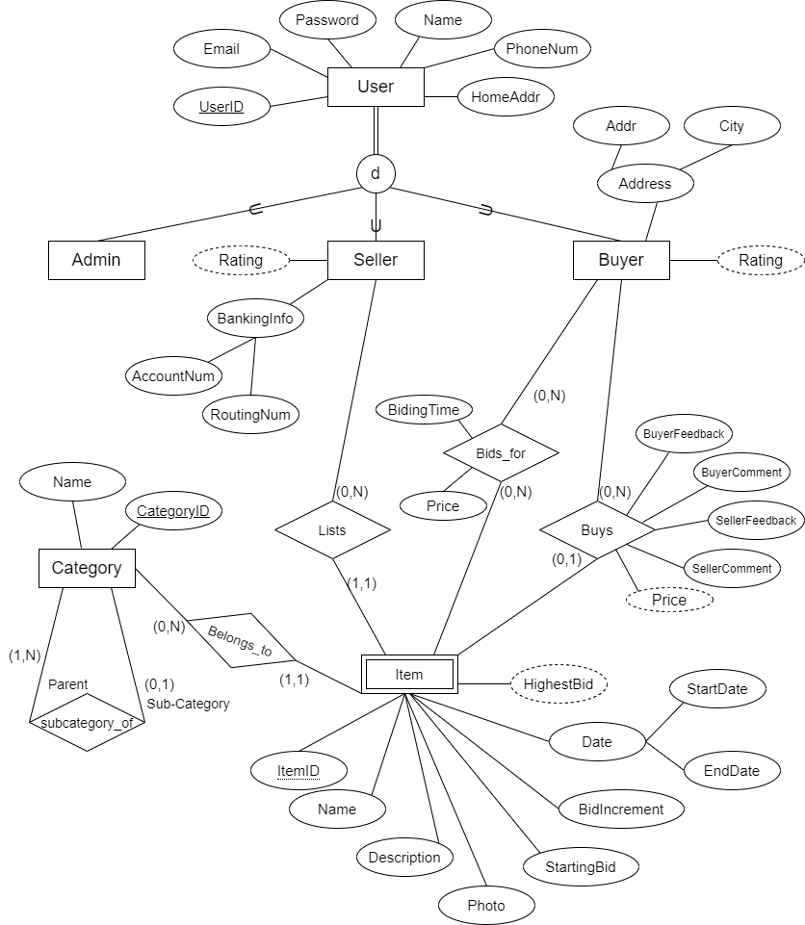
Conceptual Diagram
Link to full resolution diagram:
ER Diagram

Slide 6
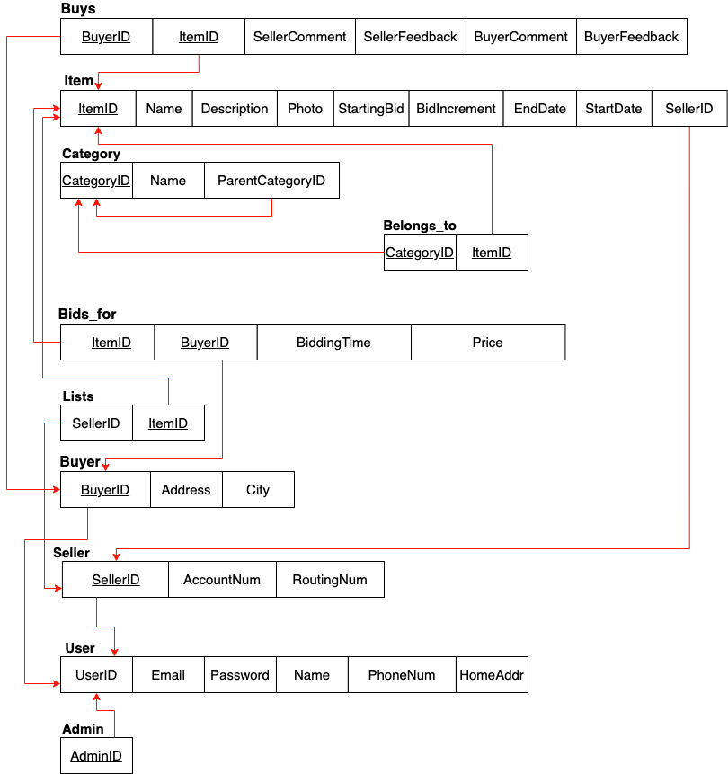
Database Schema

Slide 7
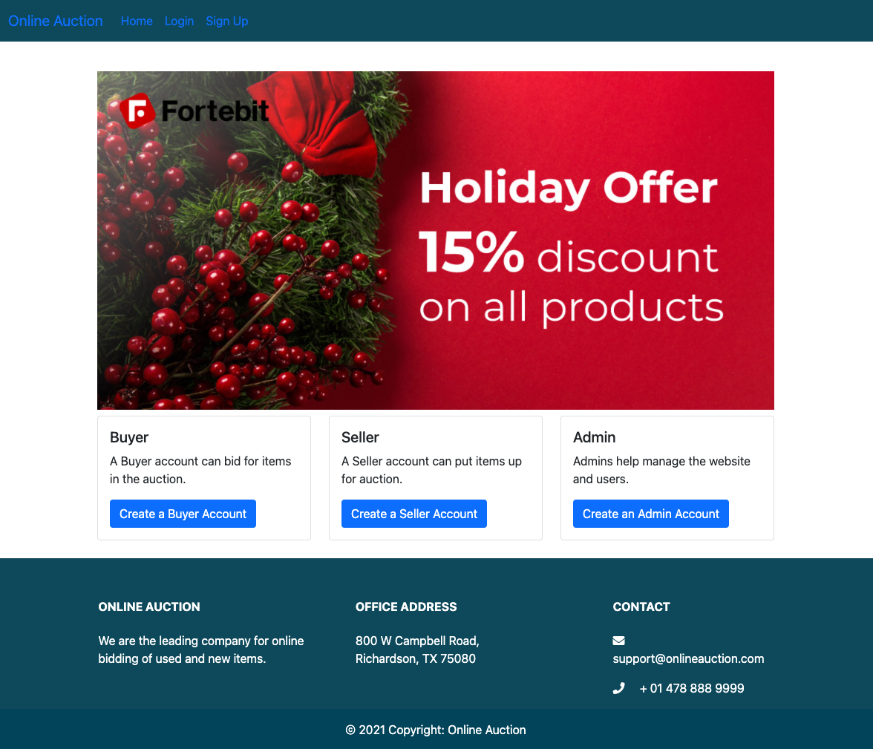
Installation Procedure
Install MySQL
Run schema.sql to initialize the database
Install Python 3 and Pip
Run pip install -r requirements.txt to install dependencies
Create a configuration file called config.json, based off of config.example.json (included in the source code) and populate its values with your database’s setup. The database should be ONLINE_AUCTION.
Run python main.py
Navigate to http://localhost:5000

Slide 8




Frameworks and Libraries and Tools

Slide 9

Demo

